Slide 1

Religion and Philosophy: Part 3

Slide 2
Islam
It is the second largest religion in the world.
It is the predominant religion in:
  Middle East from North Africa to Central Asia
  Indonesia
  Pakistan
  Bangladesh
It is also the youngest of the world religions.
The religion is diffusing rapidly to other areas.

Slide 3
Origin of Islam
  Along with Jews and Christians, Muslims trace their religion to the children of Abraham.
  The prophet Muhammad, who was born in Makkah (also spelled Mecca), founded Islam (c. 610).
  The Angel Gabriel gave Muhammad the elements of the gospel which were put into the holy book of the religion, the Quran.
  Muhammad migrated to Medina, where people listened to and adopted his declarations.

Slide 4
Five Pillars of Faith
Reciting the words of witness
Worshipping five times a day facing Mecca
Giving alms (money or food) to the needy
Fasting during the holy month of Ramadan
Making a pilgrimage to Mecca at least once during a lifetime

Slide 5
Branches of Islam
Sunni
  Arabic for “orthodox”
  83% of Muslims
  Dominant in Saudi Arabia
Shiite
  70% live in Iran or Iraq

Slide 6
Islam
The Sunni believe that successor should be chosen by agreement among the religion’s leaders.
The Shiite believe that the successor should be a member of Muhammad’s family.
Differences have often led to conflict.

Slide 7
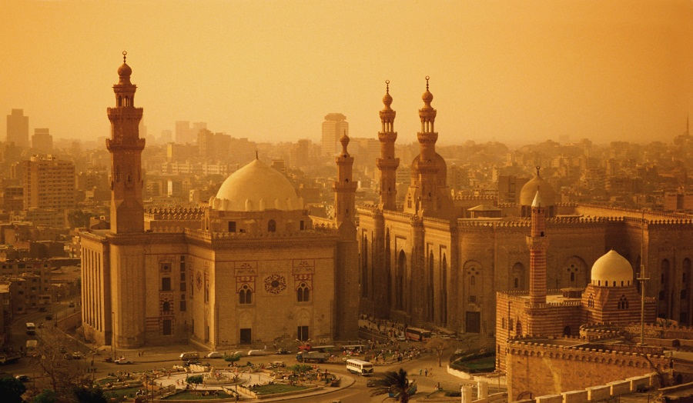
Islam
The split between the Sunni and Shiite branches occurred over the rightful successor to Muhammad, the religion’s founder.
Al-Rifa'i Mosque
Egypt

Slide 8
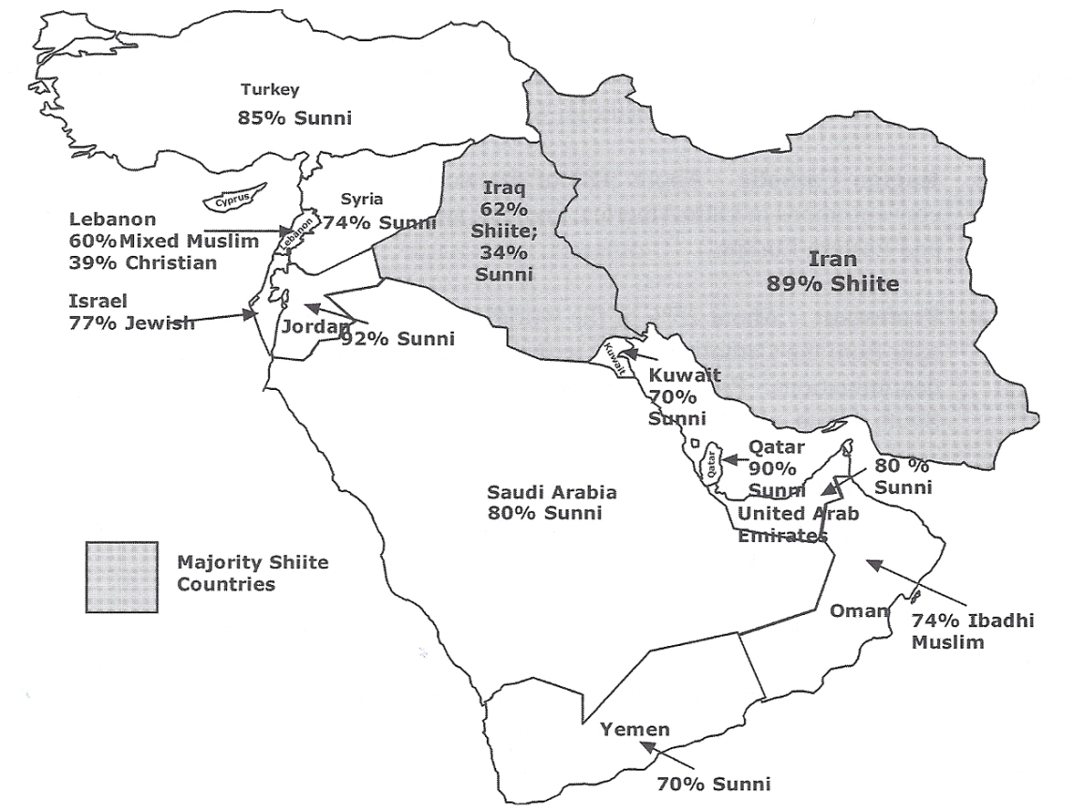
Only two countries in the Middle East are majority Shiite: Iran and Iraq. All the rest, with the exception of Lebanon and Israel, are majority Sunni. Historically, there have been many tensions between the two groups.
Sunnis and Shiites in
the Middle East

Slide 9
Diffusion of Islam
Hearth —Southwest Asia (Mecca, Saudi Arabia)
Muslim armies took over portions of northern Africa, Asia (including India), and southern Europe and converted many non-Arabs, often through intermarriage.
The religion has been diffused by missionaries and through trade.

Slide 10
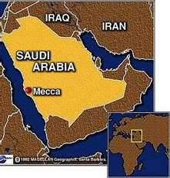
Mecca, Saudi Arabia

Slide 11
Organization of Space
Mosques—Muslim house of worship; Minarets are towers which are features of mosques where a muzzan summons people to pray

