Slide 1

Religion and Philosophy:
Part 5

Slide 2
Hinduism
Hearth: India
Only two of the major religious traditions do not trace their origins to a specific individual teacher or foundation figure. Hinduism is one of those religions.
An ethnic religion

Slide 3
Hinduism
It is the world’s third largest religion.
Most adherents live in India.
It is generally regarded as the world’s oldest organized religion.

Slide 4
Facts about Hinduism…
The word “Hinduism” comes from an ancient Persian word meaning “river.”
About 80% of India’s population regard themselves as Hindus and 30 million Hindus live outside of India.
There are close to one billion Hindus worldwide.
Hinduism is the third largest religion in the world.

Slide 5
Hinduism
The religion has no central god or single holy book.
There is a belief in the existence of a universal spirit (Brahman) that manifests itself in many shapes and forms, including Vishnu and Shiva.

Slide 6
More facts about Hinduism…
The religion includes numerous traditions.
Scholars describe modern Hinduism as the product of religious development in India that spans nearly four thousand years, making it the oldest surviving world religion.
Hindus believe that there are many paths to “god.”
Original language: Sanskrit

Slide 7
Organization of Space
Place of worship: temple or home shrine

Slide 8
MAJOR HOLIDAYS
Include:
  Diwali: “Festival of Lights” (mid-November)
  Holi: Spring

Slide 9
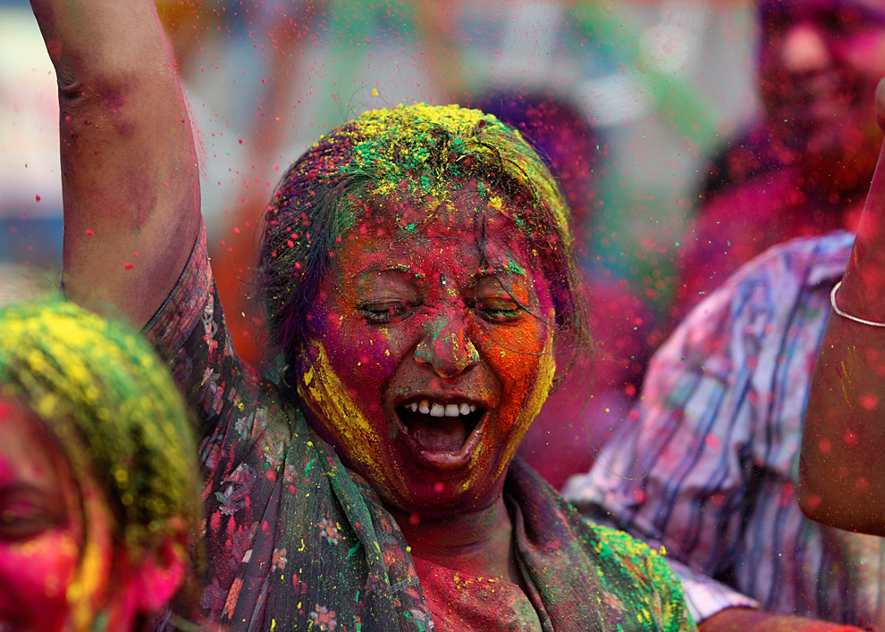
Holi

Slide 10
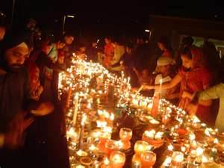
Divali

Slide 11
What about the Caste System?
The subject remains controversial in India today.
Theoretically, there has been a movement away from the caste system (e.g. Brahmans—highest caste—priests).
The concept of untouchables has been outlawed.

Slide 12
JAINISM
Hearth: South Asia
Stresses spiritual independence and equality of ALL life.
Jainism does not include a belief in an omnipotent supreme being or creator, but rather in a universe regarded as eternal and governed by natural laws .

Slide 13
Beliefs of Jainism
Strong belief in nonviolence
Every living thing has a soul; even killing an insect is evil.
Followers are REQUIRED to be vegetarians.

Slide 14
Jainism and Diet
As part of its stance on nonviolence, Jainism goes even beyond vegetarianism, in that the Jain diet also excludes most root vegetables.
Observant Jains do not eat, drink, or travel after sunset, and always rise before sunrise.

Slide 15
The Ethical Code of Jainism
The ethical code of Jainism is taken very seriously. Summarized in the Five Vows, they are followed by both lay people and monastics. These are:
  Nonviolence
  Truth
  Non-stealing
  Chastity
  Non-possession or Non-possessiveness

Slide 16

The Chinese Religions/Philosophies
Buddhism often blends with local belief systems, including Confucianism and Daoism, both of which are often viewed as philosophies.

Slide 17
The Chinese Religions
Confucianism provides a code of moral conduct based on humaneness and family loyalty.

