Slide 1

Religion and Philosophy: Part 2

Slide 2
Christianity in the
United States
There are regional differences which means that most people live in communities where one denomination predominates.
  Baptists: southern states
  Methodists: Northeast and Southwest
  Lutherans: Minnesota and North Dakota
  Mormons: Utah
Patterns have been determined PRIMARILY because of migration/settlement patterns.

Slide 3

Diffusion of Christianity
Hearth—Palestine
Missionaries—individuals who help transmit a universalizing religion through relocation diffusion

Slide 4
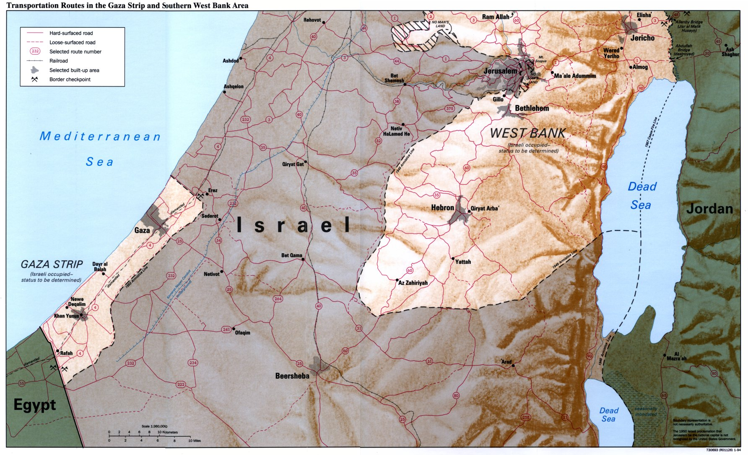
Palestine

Slide 5
Diffusion of Christianity
Believers who had daily contact with pagan non-believers (pagans: word that was once used to describe a follower of a polytheistic religion; Latin for “countryside”)
Occurred with the spread of the Roman Empire; migration of Europeans who settled in various areas

Slide 6
Organization of Space
Church: place where Christians go to worship
Regular, collective worship is important to followers
Maintenance and construction requires wealth
Roman Catholic and Eastern Orthodox churches tend to be more elaborate than Protestant churches, especially in North America (more modest)

Slide 7
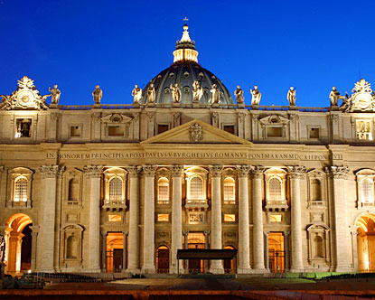
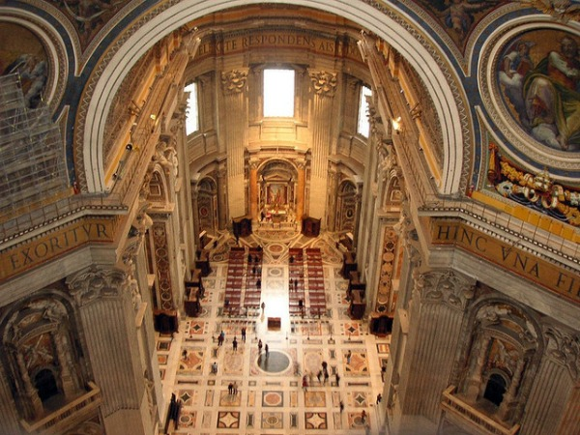
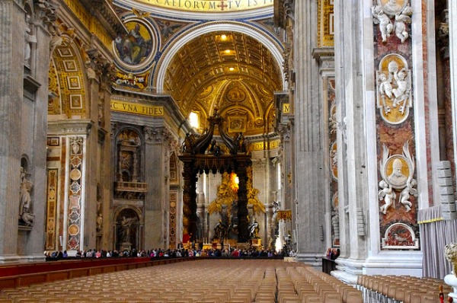
St. Peter’s Basilica
Vatican City
Click on this link to learn more!
Vatican City

Slide 8
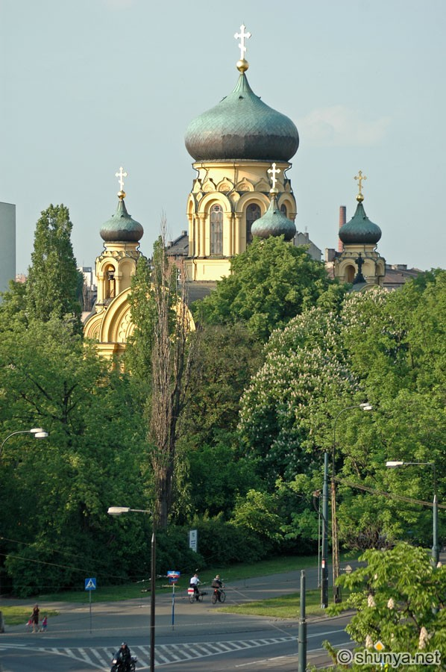
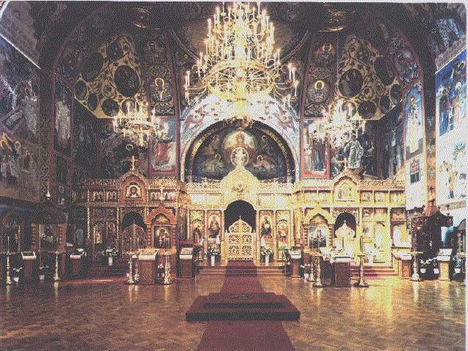
Eastern Orthodox Church
Take a moment and notice the details of the architecture.

Slide 9
Islam
More than 1 billion followers
Dominates North Africa to Central Asia
Islam means “submission to the will of God.”

Slide 10
Islam
It is the second largest religion in the world.
It is the predominant religion in:
  Middle East from North Africa to Central Asia
  Indonesia
  Pakistan
  Bangladesh
It is also the youngest of the world religions.
The religion is diffusing rapidly to other areas.

