Slide 1
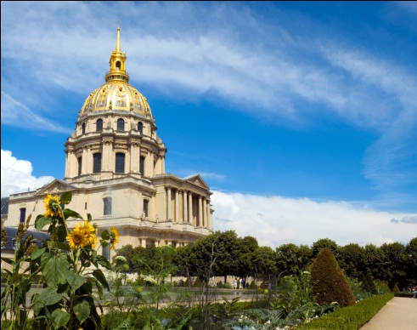
Religion and Philosophy:
Part 6

Slide 2
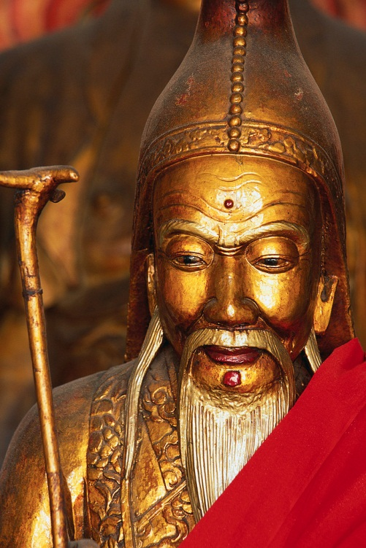
CONFUCIANISM
Hearth: China
Confucius was a famous thinker and social philosopher of China, whose teachings have deeply influenced East Asia.

Slide 3
Confucianism and Its Tenets
Concerned with:
  Good conduct
  Practicing wisdom
  Exercising proper social relationships
Confucius and Government:
  Believed in a paternalistic government —citizens should obey governments as they would their father; sovereign is honorable; citizens are respectful and obedient
  Leaders —seek moral perfection; set good examples for citizens

Slide 4
Quotes from Confucius
“Only the wisest and stupidest of men never change.”
“Real knowledge is to know the extent of one’s ignorance.”
"I hear and I forget. I see and I remember. I do and I understand."
"Our greatest glory is not in never falling, but in rising every time we fall."
Take a moment and reflect on the meaning of each of the quotes.

Slide 5
The Chinese Religions/Philosophies
Daoism holds that human happiness lies in maintaining proper harmony with nature.

Slide 6
Shintoism
It is a native ethnic religion of Japan.
It focuses on nature and reverence of ancestors.
Although it is no longer the state religion of Japan, it still thrives in the country.
Prayers are offered to ancestors and shrines mark reverence for house deities.

Slide 7
Shamanism
Shamanism is an ethnic religion in which people follow their shaman, a religious leader and teacher who is believed to be in contact with the supernatural.
Shamanism is reflected on the “totem poles” of North American natives. →

Slide 8
Shamanism
Shamans in East Asia are believed to be in contact with the ancestors.
In Africa, shamanism takes the form of animism, the belief that inanimate objects (rocks, rivers, plants) have spirits and conscious life.

Slide 9

Traditional Religions
Traditional religions are an integral part of a local culture and society.
Example: Shamanism
Example: Native African religions

Slide 10

Asian Philosophies

Slide 11
Naturalism
Hearth: China (although roots are in Greece)
This philosophy tried to explain the workings of nature by certain cosmic principles —principles that applied to the universe.
The supernatural and nature are one in the same.

Slide 12

Naturalism
The philosophy is concerned with dualism, or the two-sidedness, of nature.
Dualism of nature defined as: yin and yang:
  Yin—female, dark, cold, and passive
  Yang—male, light, hot, and active

Slide 13
More about Naturalism…
Yin and yang do not conflict with one another. They depended on one another and constantly maintained a balance.
Examples: day gives way to night; summer gives way to winter
Naturalists strongly believed that balance in human affairs was inevitable.
Example: harsh government or anarchy could not exist for very long

Slide 14
Legalism
Like Confucianism, this philosophy concerned itself with politics.
Followers of legalism, however, believed in power, not virtue, and harsh punishment for violating laws.

Slide 15
Legalism
Like Confucianism, this philosophy concerned itself with politics.
Followers of legalism, however, believed in power, not virtue, and harsh punishment for violating laws.

Slide 16
The Legalists’ View
By nature, people are selfish and not trustworthy. Peace and prosperity may only be achieved by threatening harsh punishment.
The connection with naturalism? Followers believed that balance had to also be achieved in order for legalism to work!
Powerful government controlled by officials who believed in ethical principles of righteousness and who were compassionate.

Slide 17
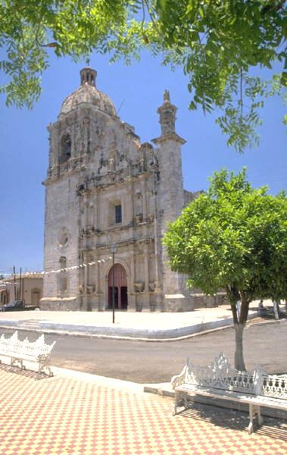
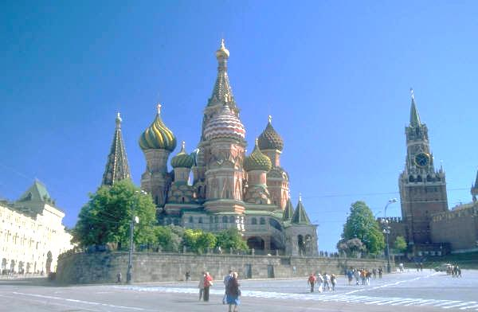
The Spatial Impact of Religions
In large cities around the world, the tallest, most centralized, and elaborate buildings are often religious structures.

Slide 18
The Spatial Impact of Religions
Shrines are located near water, because water is part of sacred rituals.
It is believed that gods will not venture far from water.

Slide 19

The Spatial Impact of Religions
Bodhi trees are protected in Buddhist lands marking the cultural landscapes of many villages and towns.

Slide 20

The Spatial Impact of Religions
An important religious land use that impacts the cultural landscape has to do with disposing of the dead.
Practices include:
  cemeteries
  cremations

